Slide 1
Partners of Scott County Watersheds Scott County Water Quality Snapshots What does the data show?
Steve Gustafson, PG, ICGP
PSCW Vice Chair

Slide 2
Background
PSCW – diverse group with mission to develop and implement ways we can be better stewards of watersheds in Scott County. (reps from County, Bett, Dav, Eld, Corn Gwrs, citizens, EICC)
Since 2000 water quality data has been collected annually in fall and spring.
PSCW coordinates snapshots, hosted by Bettendorf or Davenport.
Utilizes volunteers/city staff to collect and analyze water samples.
Utilized Iowa DNR IOWATER program for equipment and resources until 2017.

Slide 3
Background
239 sample sites throughout Scott County through the years. (not all by PSCW, mostly streams & some lakes)
Analyzed for nitrate, nitrite, phosphorus, chloride, pH, dissolved oxygen, air/water temperature, transparency, water color. Identified issues in local environment.
Chemicals analyzed with field kits or test strips (some lab analyses though)
Indicator bacteria lab analyses also conducted until 2014 (e coli).
Other testing in County done by state, federal or municipalities, only included relevant data (no metals, pesticides, etc)

Slide 4
Background
Fall 2017 collected all data from Iowa DNR and local resources to generate a Scott County Database (Oct 2000 to Oct 2017):
1999 e coli analyses
2655 water temperature results
774 air temperature
2268 transparency
3021 phosphorus
2605 dissolved oxygen
2354 nitrite
2354 nitrate
2457 pH
2561 chloride

Slide 5
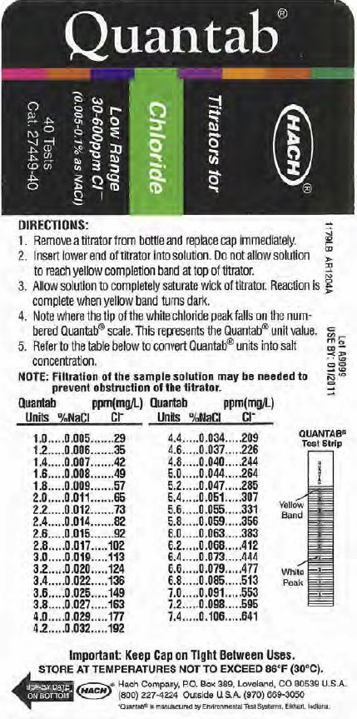
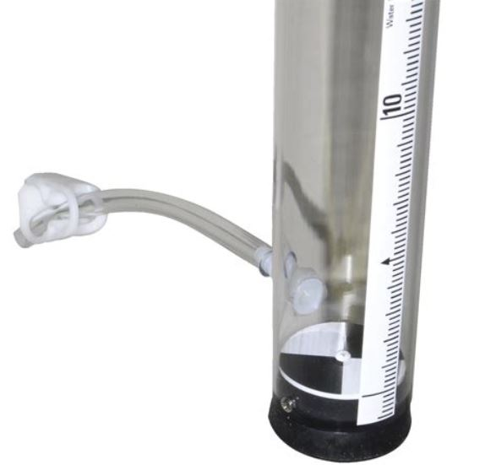
IOWATER Sampling Equipment

Slide 6
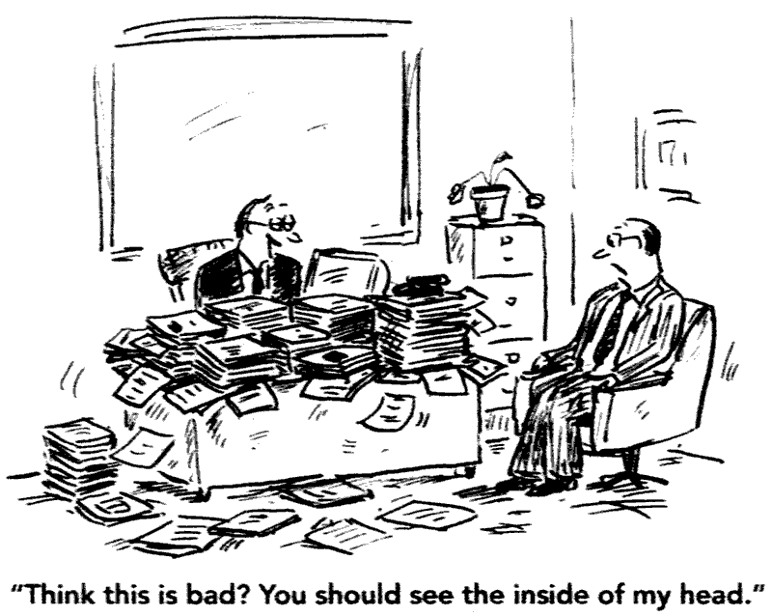
OK, we have a lot of data……now what?

Slide 7
Large database offers opportunities:
Not many counties have this much data over a long period.
Determine trends, changes since inception.
Identify areas of concern.
Dispel conventional wisdom.
Identify education and stewardship opportunities.
Let’s get started…..

Slide 8
Methods
Of the 239 locations, 55 had a dataset over 10 years (minimum threshold).
Calculated average concentrations of nitrate, nitrite, phosphorus, chloride, transparency, dissolved oxygen and pH for each sample location over sample period.
Generated charts of concentrations vs. time for each parameter, as to determine a line slope and trend.
This data analysis enabled generation of a Matrix…

Slide 9
©Warner Brothers Entertainment Inc

Slide 10
Why a matrix?
The key is determining trends.
Most parameters don’t have water quality standards.
Assumes that optimum condition for a water body is a desirable trend.
Allows for comparison of a trend (Up, Down or Stable) for each sample location, parameter and water body.
Also allows for comparison of average value to a reference value for a parameter.
Enables a focus on areas of concern.

Slide 11
Matrix
Trends determined by calculating slope of concentrations charts for each parameter in Excel©.
Up trend means a positive slope, Down is a negative slope, Stable means very small or undeterminable slope.
Generally we don’t want an Up trend, we like Down trends, and depending on the average concentration, Stable can be desirable or not desirable.
Transparency and Dissolved Oxygen special cases, they are the opposite, Down is not optimum.
pH is a range (6-9), so Stable is optimum if avg is OK.

Slide 12
Example parameter chart indicates why a long term dataset is important

Slide 13
Locations used for Matrix

Slide 15
Matrix
DNR reviewed methodology, agreed and made suggestions, but will not comment on report.
Key is the trends. The reference values and averages add accuracy.
Had to research reference values to compare averages to, so to determine if a trend warranted concern.
Two sets of reference values.
First based on IOWATER concern levels (if average exceeds these site is a high concern and coded Red in Matrix)
Second based on literature (if exceeded coded Yellow in Matrix).
Green means average below both reference levels!
Neither one enforceable by state or feds. Nether one based on drinking water standards.
For instance, pH has a desirable range of 6-9, dissolved oxygen desirable at 5 mg/L and above, phosphorus negative impacts above 0.1 mg/L.
No standards from state or feds anytime soon, at least for nutrients. Variable, hard to obtain, controversial.
Trends
Red = not desirable
Yellow = stable
Green = desirable
Remember, desirable can mean Up or Down trend, depending on the parameter

Slide 16
Matrix
Color coding based on trend and average values (as compared to reference values)
For instance for a given parameter:
Red trend and a red average = sample location a high concern
Red trend and a yellow average = sample location a concern
Yellow trend and green average = not a concern
Green trend and green average = not a concern
9 determination categories total.

Slide 17
Matrix
Utilized Matrix to review each sample location and associated stream for each parameter.
26 Streams in Matrix and one storm sewer
Rural: 12
Urban: 7
Remaining 7 Suburban/Rural or Suburban/Rural

Slide 18
Results
Nitrates:
No areas of high concern, one location with average above drinking water standard (not a DW source).
Trends mostly Up or Stable in rural settings.
Mix of Up, Stable, Down in suburban.
Mostly Up in urban.
Most sample locations had average values between 1 and 6 mg/L. Rural settings tended to have higher averages.
Nitrates are present and a concern for Rural, Suburban and Urban settings.

Slide 19
Results
Nitrites:
No areas of high concern.
Short lived chemical in nitrogen cycle.
Minor concern in rural and suburban settings.
Trends are predominantly Down or Stable.
Only one location with average above reference value.

Slide 20
Results
Transparency:
One area of high concern, rural location Spencer Creek.
Trends a mix in all 3 settings.
Lower values (less transparent) tended to be in rural settings.
A concern in suburban and rural settings.

Slide 21
Results
Phosphorus:
All locations had averages above reference level.
Portions of Blackhawk Creek (rural reach), Candlelight Creek, Pigeon Creek West, I-80 Unnamed Creek, Crow Creek are areas of high concern.
Higher averages tended to be in rural locations (>0.3 mg/L), but urban and suburban not much lower (0.2 mg/L).
Generally Up in urban and suburban, mixed in rural.
Present and a concern in all 3 settings.

Slide 22
Results
Dissolved Oxygen:
Two areas of high concern. Candlelight Creek, Hanlin Creek.
Trends generally down (not desirable) in rural settings (but high average concentrations though). Mix for suburban and urban.
Minor concern for urban and suburban settings.

Slide 23
Results
Chloride:
Areas of high concern: Candlelight Creek, portion of Duck Creek, Greenway Creek, Hanlin Creek, Pheasant Creek, Pigeon Creek West, Robin Creek, Stafford Creek, Unnamed I-80 Creek. One storm sewer had highest average at 300 mg/L.
Trends generally up in urban and rural settings. Mix for rural.
Present and a concern for urban and suburban settings.
State WQ standards exist, calculated for individual water body.

Slide 24
Results
pH:
No concerns!

Slide 25
Results
Bacteria impairment:
No recent data since 2014.
E coli is an indicator species of fecal contamination. Some concern of validity as a indicator, but USEPA in 2012 recommended to continue using it.
Virtually all locations have values that exceed the Duck Creek TMDL of 126 org/100 ml. (probably same standard would be used for other watersheds)
Current DNR 303 (d) bacteria impairments in Scott County: Duck Creek, Crow Creek, Stafford Creek, Candlelight Creek, Robin Creek, Goose Creek, Silver Creek, Pheasant Creek, Lake of the Hills.
Trends can’t be determined, too sporadic and ubiquitous.
Present and a concern for rural, urban and suburban settings.
More later….

Slide 26
Results
Accuracy:
IOWATER kits never as accurate as a laboratory, but cheaper and easier.
Mid 2000’s split samples collected by Iowa DNR (328 total). Allows for comparison of nitrate/nitrite IOWATER results to lab results. P could not be compared.
83% of field test results were less than the corresponding lab result.
Average difference was 4 mg/L.
Margin of error be estimated at 4 mg/L for nitrate/nitrite IOWATER field results, emphasizing likely underestimating actual value.
More later….

Slide 27
Results
Comparison to other Iowa Counties:
Not all have a large dataset as Scott County
Compared nitrate and phosphorus IOWATER data average concentration for entire County. Difficult to compare, different geomorphic (landform) regions.
Nitrate
61 of 99 counties had data to compare to
Scott County average 3.2 mg/L, we are 48th of 62. Missing 1/3 of Iowa to compare to though.
Phosphorus
90 of 99 counties had data to compare to
Scott County average 0.4 mg/L, we are 17th of 90. Eight other counties same average.

Slide 28
Results
May 2018 Snapshot:
Revised sample locations to ensure greater coverage, efficiency, and avoid duplication.
48 sample locations. Two ponds with floating treatment wetlands.
9 locations split sample, lab analysis for NO3 and P.
No surprises in results, continued trends.
Lab results
7 of 9 P field samples 0.1 to 0.2 mg/L less than lab, but lab measured TP. Highest lab result: 2.9 mg/L at 982157 (unnamed I-80 Creek).
6 of 9 NO3 field samples less or equal to lab (within 3 mg/L). Highest lab result 15.1 mg/L at 982157.

Slide 29
Snapshots -future
Fall 2017 IOWATER no more, DNR to provide some equipment and tech support. Data storage changed.
Same time Scott County, Waste Commission, Dav, Bett, Nahant, PSCW, formed committee (XWST) to keep snapshots going.
We will create a public online database for all past and current data. Also more features…sign up for events, create graphs. Through Xstream Cleanup.
Revised sample locations.
Split samples for lab analysis of select sites. Adds accuracy and validity. Nutrients and hopefully DNA fecal tracking.
Working on better sampling equipment and training.
Snapshots still coordinated by PSCW.
Spring, Summer, Fall. Summer event will have invertebrate surveys.

Slide 30
Conclusions
Nutrients a concern in urban, suburban and rural areas
Not just coming in from rural to urban
Chloride not just a urban concern.
Nutrients generally not in a desirable trend.
DO generally not desirable trend but current averages OK.
Transparency somewhat not desirable trends, few areas of concern.
Chloride somewhat up, some areas of concern.
pH is OK.
Database and Matrix allow for focus on specific parameters on specific water bodies.
Majority of streams originate within County borders, so WQ issues are our problem.
There are WQ issues:
Not the end of the world, but not great either.
Too many undesirable trends.
Scott County is probably average in Iowa for our type of landforms (more research to verify)
Biggest concerns are likely nutrients and bacteria impairments.

Slide 31
Recommendations
Continue snapshots – focus on validity, coverage, training, replicability, equipment, micro-invertebrates. Lab analysis with field analysis, add MST.
MST will allow for identification of probable fecal sources, needed to address bacteria impairments. Accurate and valuable, but expensive.
Use Matrix to focus on problem areas.
Most likely as part of larger effort, countywide water quality plan.
Some may be quick fixes, others a combined effort.

Slide 32
Questions?

