Slide 1


Cassie Druhl, Coordinator
Web: partnersofscottcountywatersheds.org
@partnersofscottcountywatersheds

Slide 2
Past and Future Trends in Precipitation in Eastern Iowa
Ray Wolf
NOAA/National Weather Service

Slide 3
Outline
Precipitation Climatology of Eastern Iowa
  30-year normals
Historic Trends
  What have we seen since the late 1800s
Future Scenarios
  What can we expect in a changing climate

Slide 4
Climatology
30-year average ending on the decade
Current normals 1981-2010
Comparisons to longer time periods
  Period of record
  20th century

Slide 5
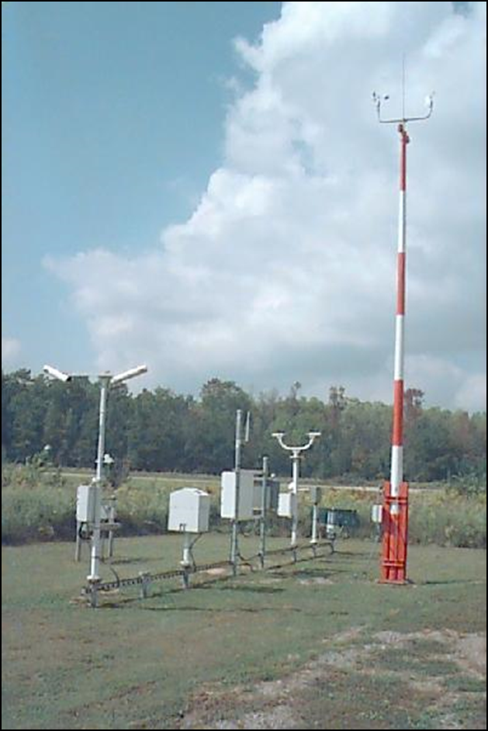
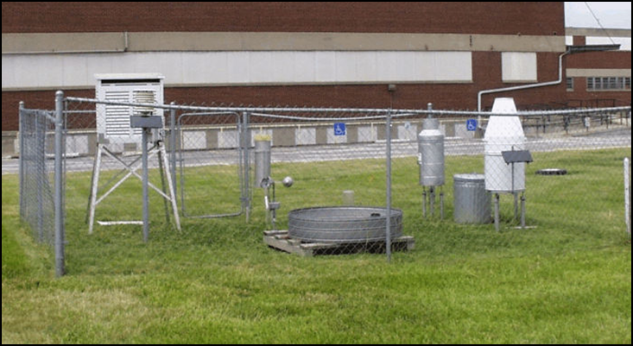
Measuring Precipitation

Slide 6
Normal and Record Precipitation
Wettest year – 56.36 in.
Average year – 37.96 in.
Driest year – 17.33 in.

Slide 7
Normal and Record Snowfall
Snowiest year – 71 in.
Average year – 31.6 in.
Least snowy year – 12.6 in.

Slide 8
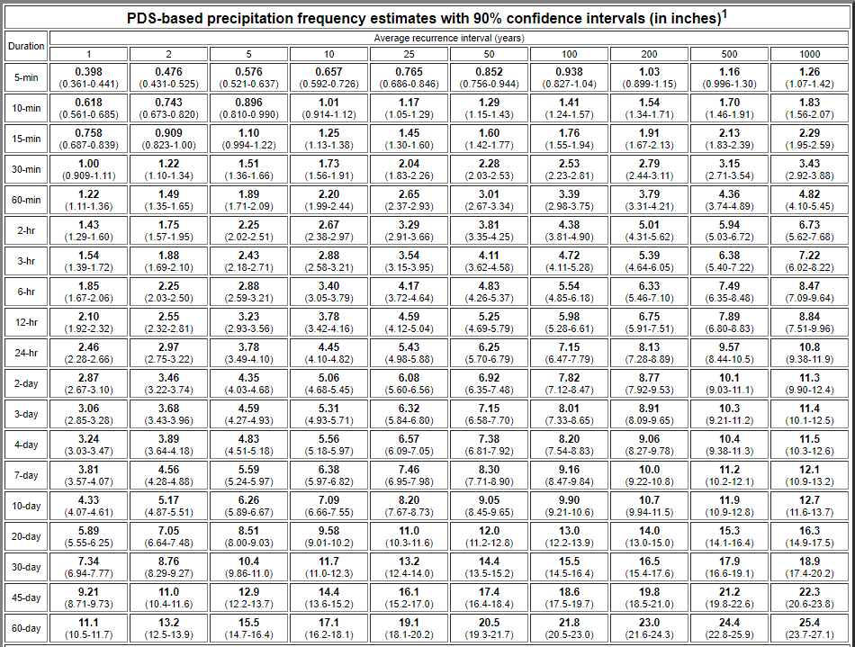
Extremes
Source:
NOAA Precipitation Atlas 14

Slide 9
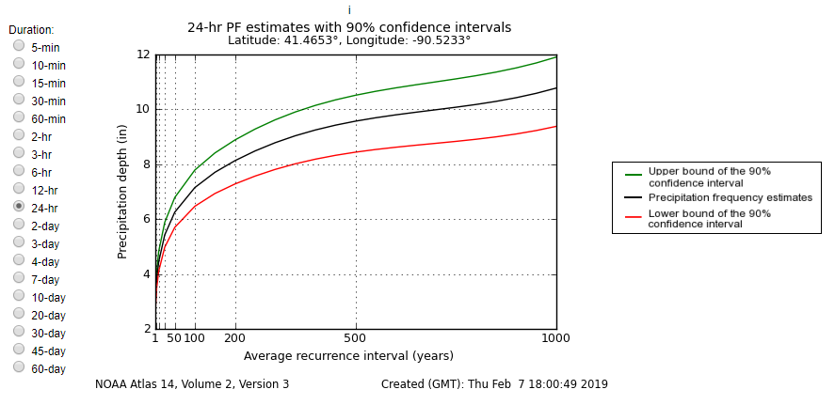
Extremes
Source:
NOAA Precipitation Atlas 14

Slide 10
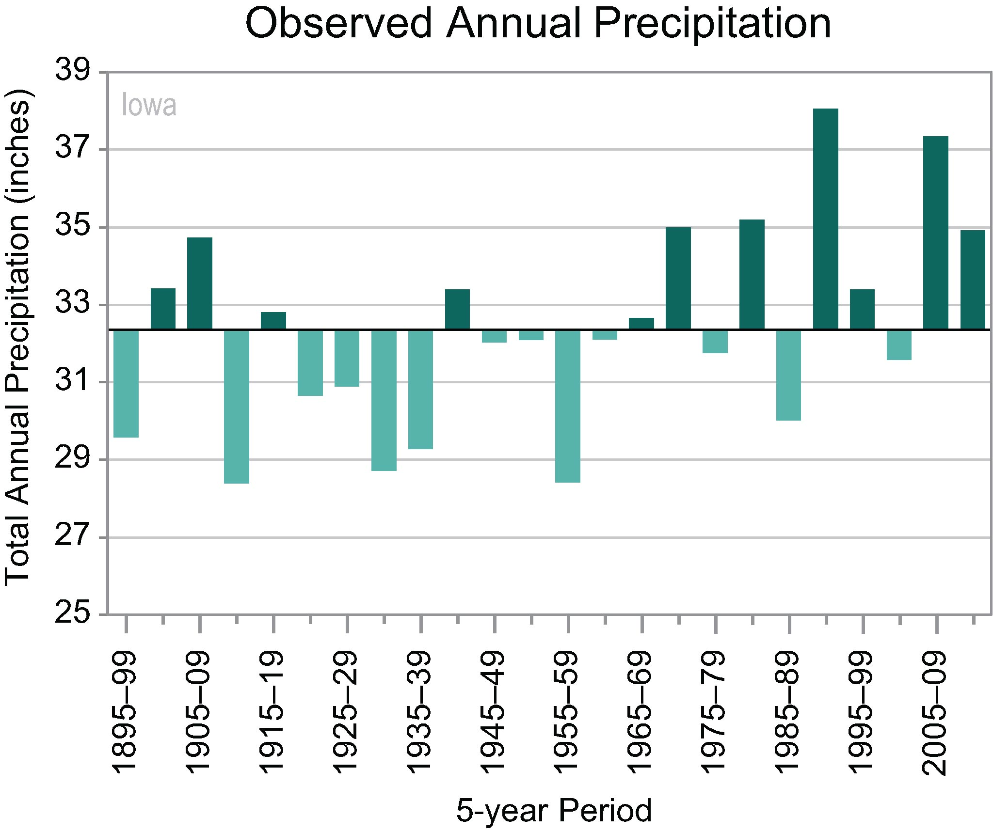
Past Trends

Slide 11
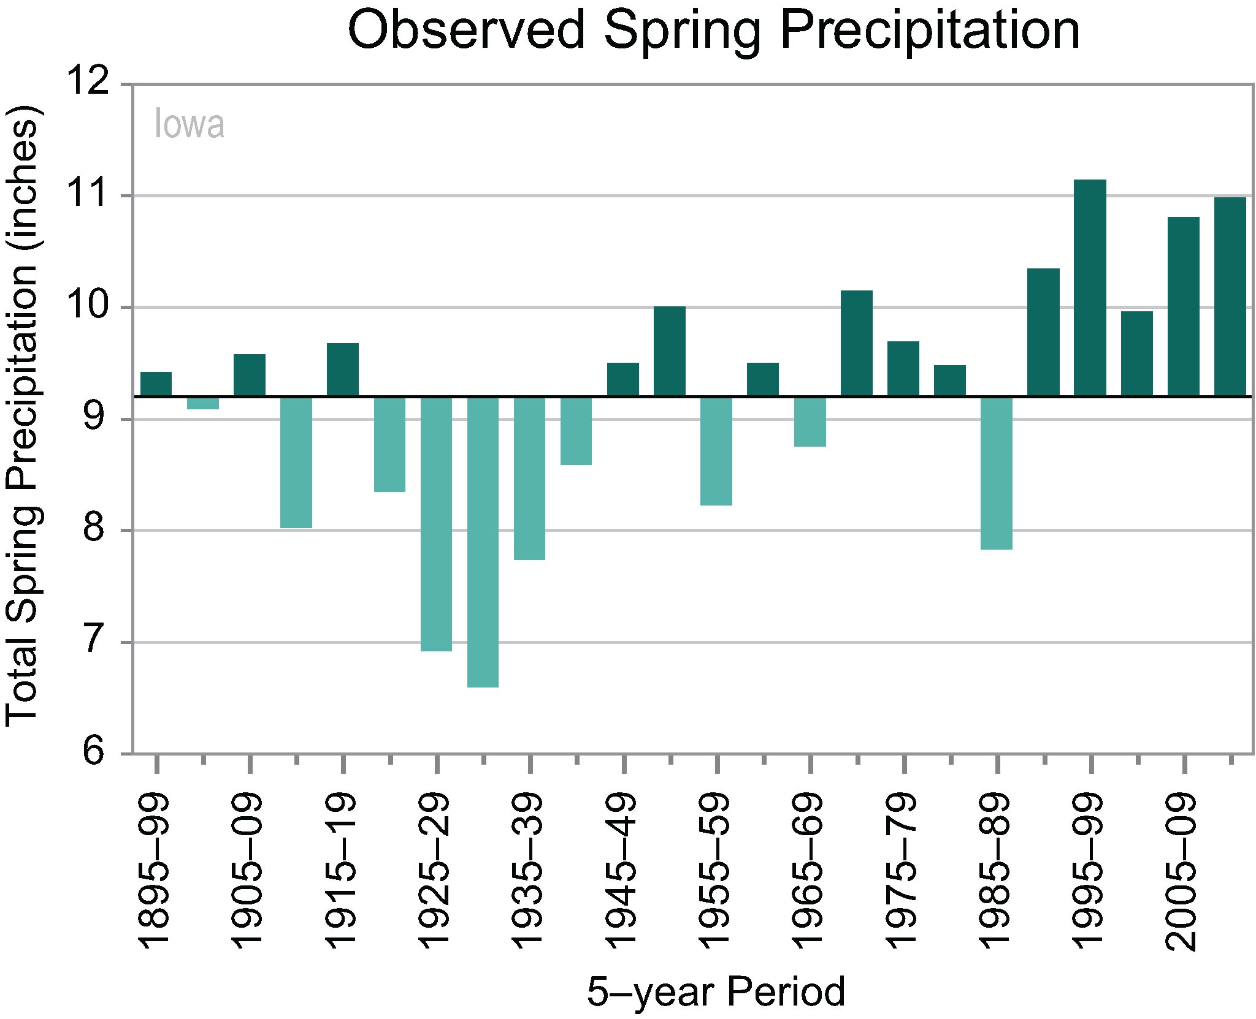
Past Trends

Slide 12
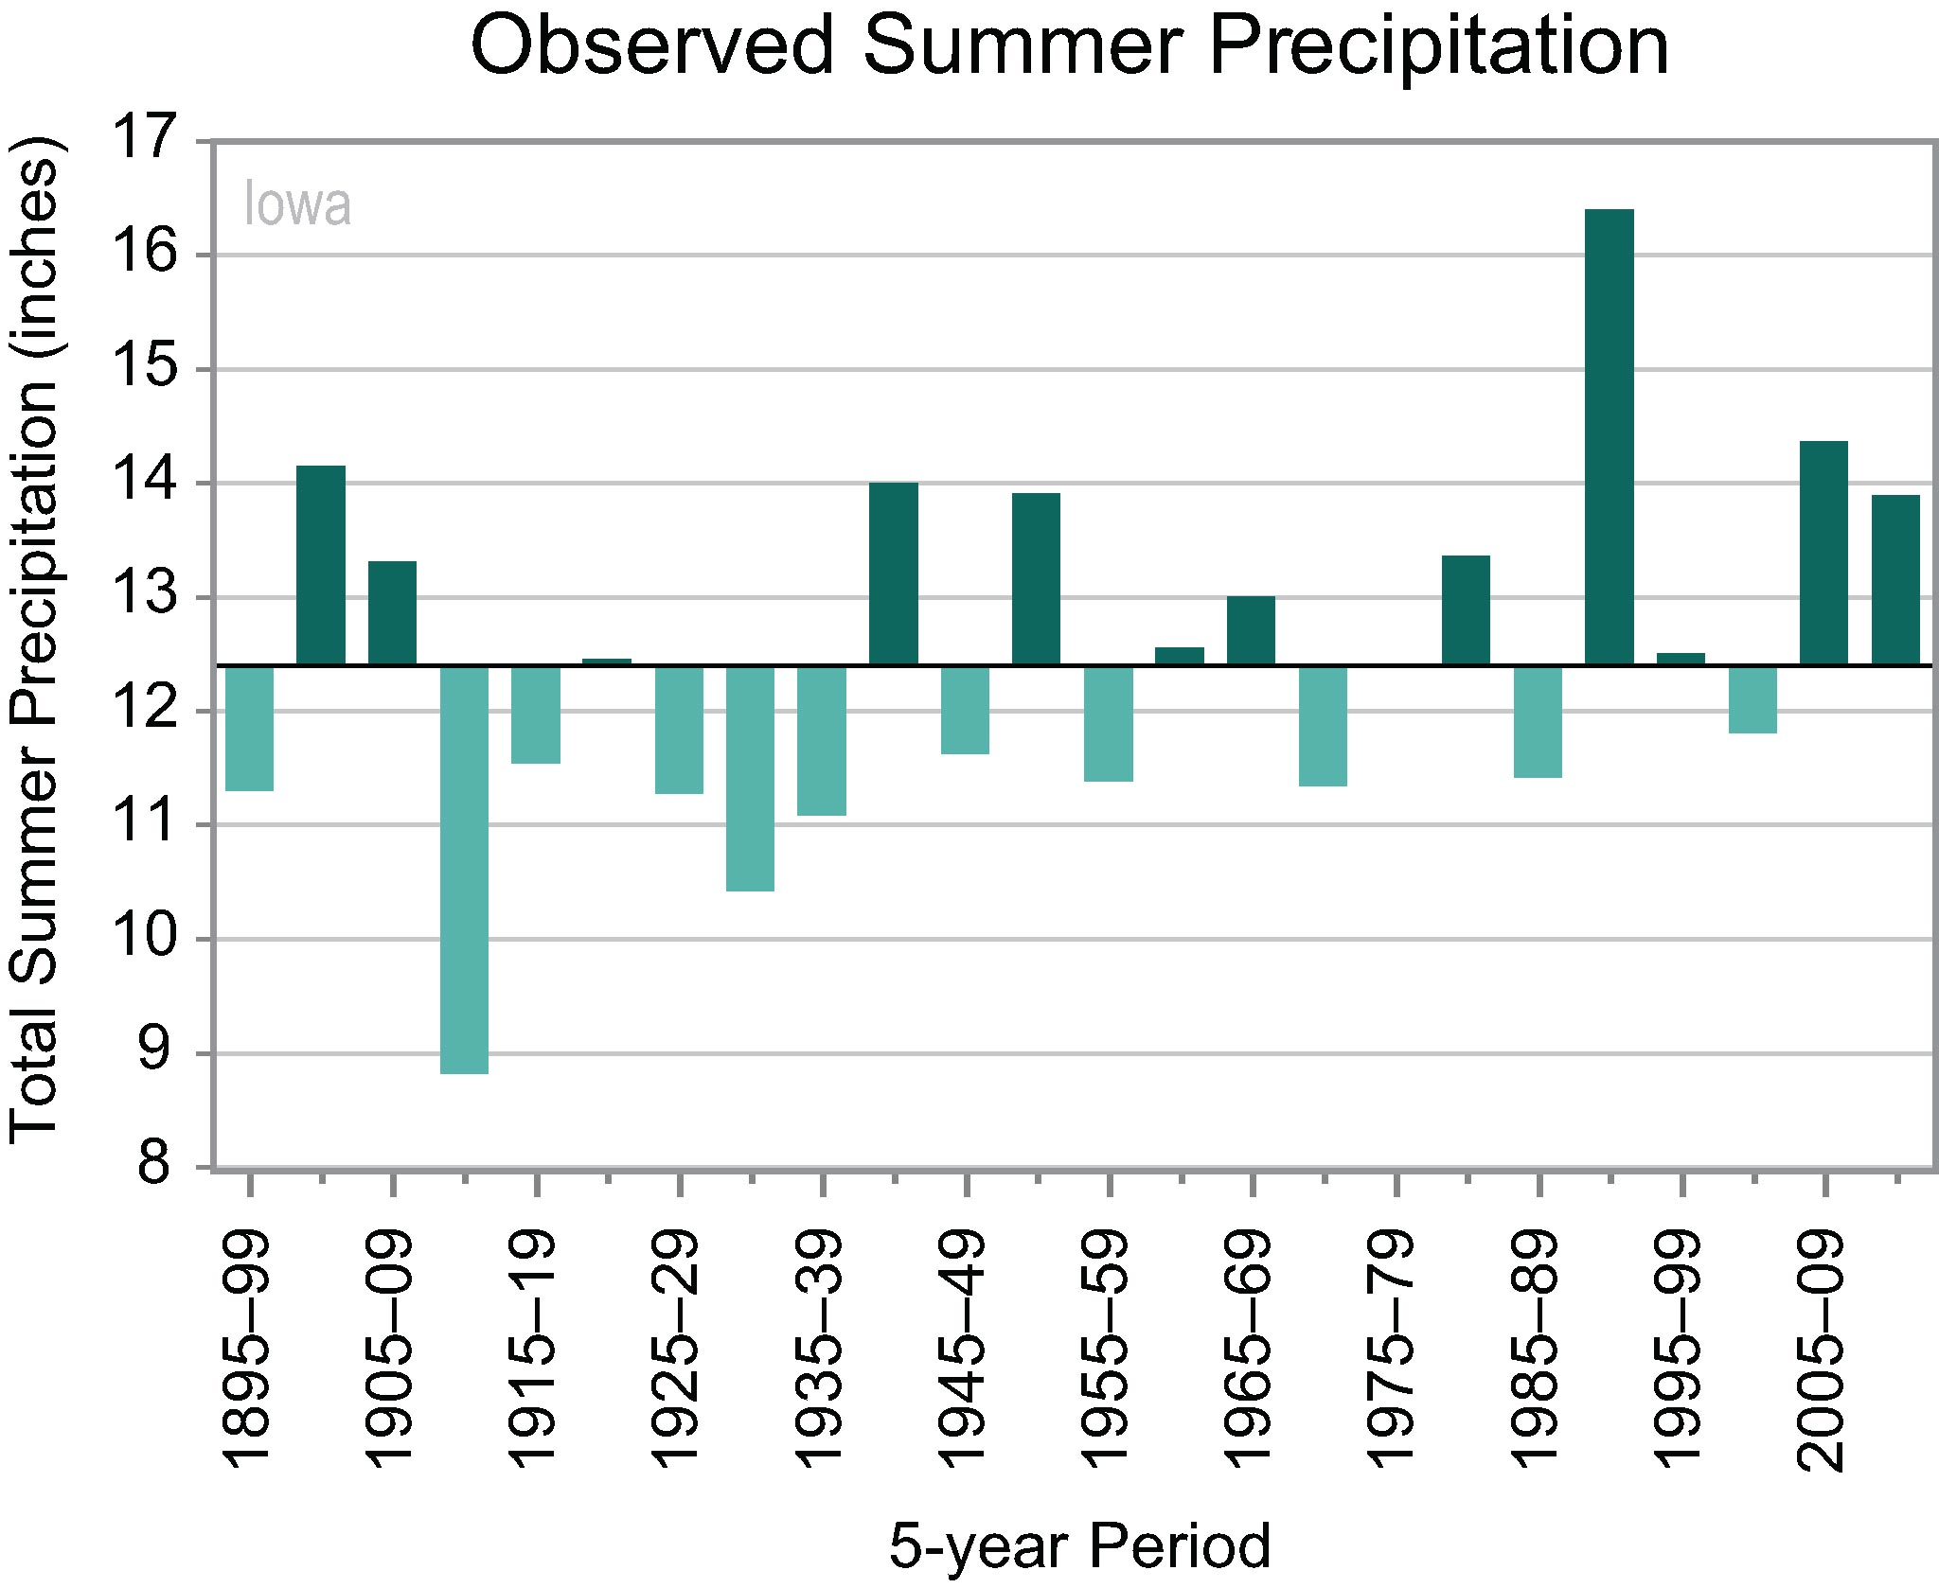
Past Trends

Slide 13
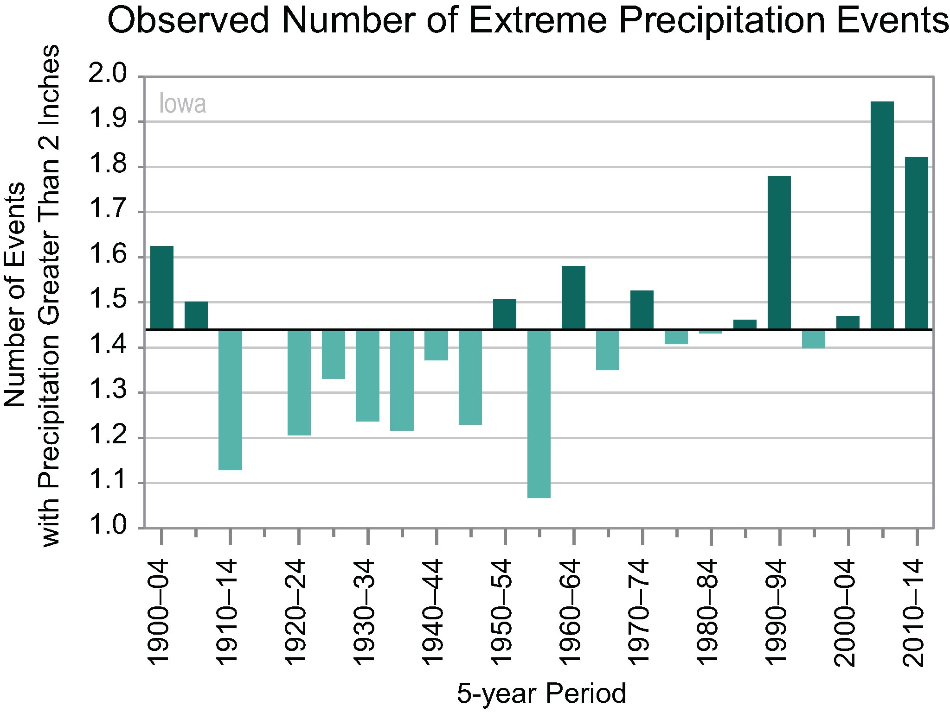
Past Trends

Slide 14
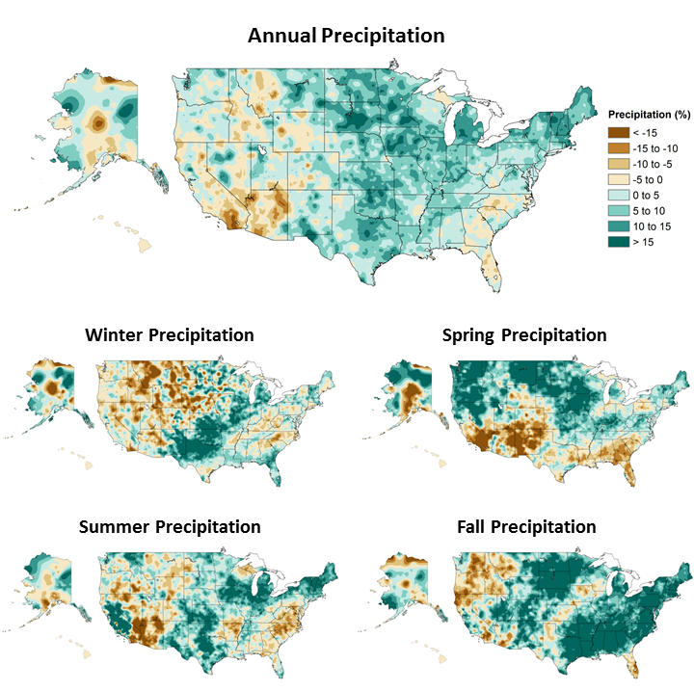
Past Trends
1986-2015 compared to 1901-1960

Slide 15
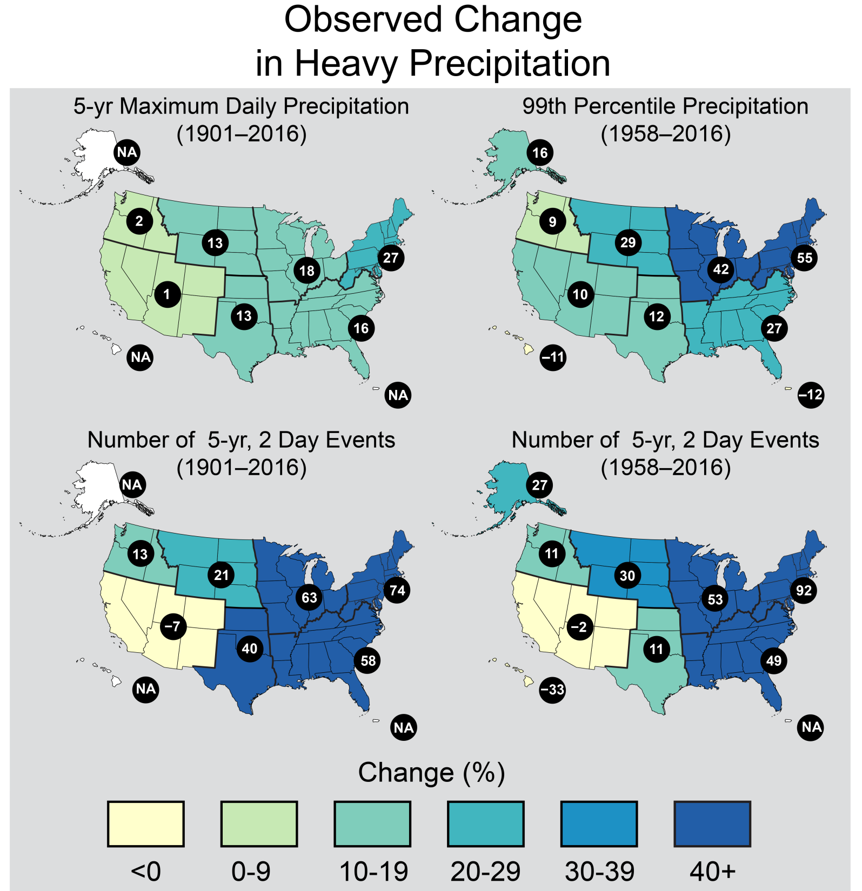
Past Trends

Slide 16
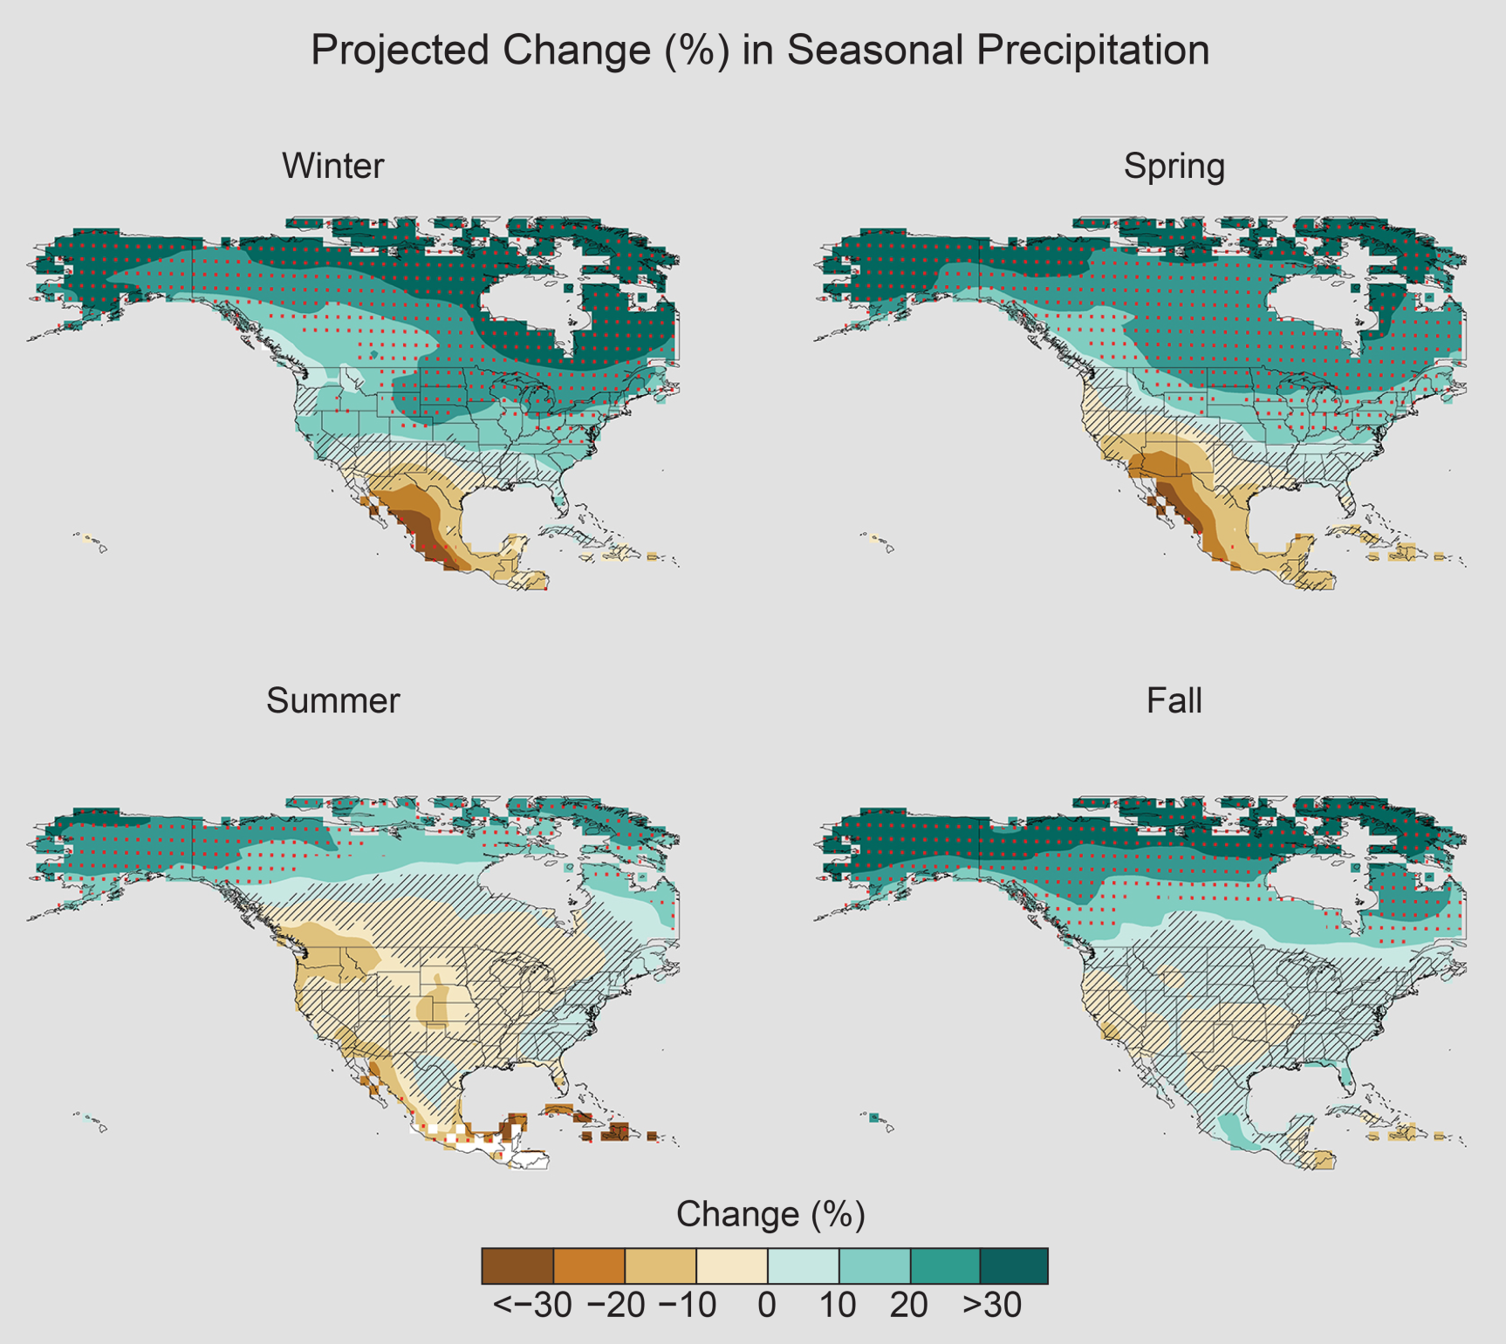
Future Trends
Late century; high emission scenario

Slide 17
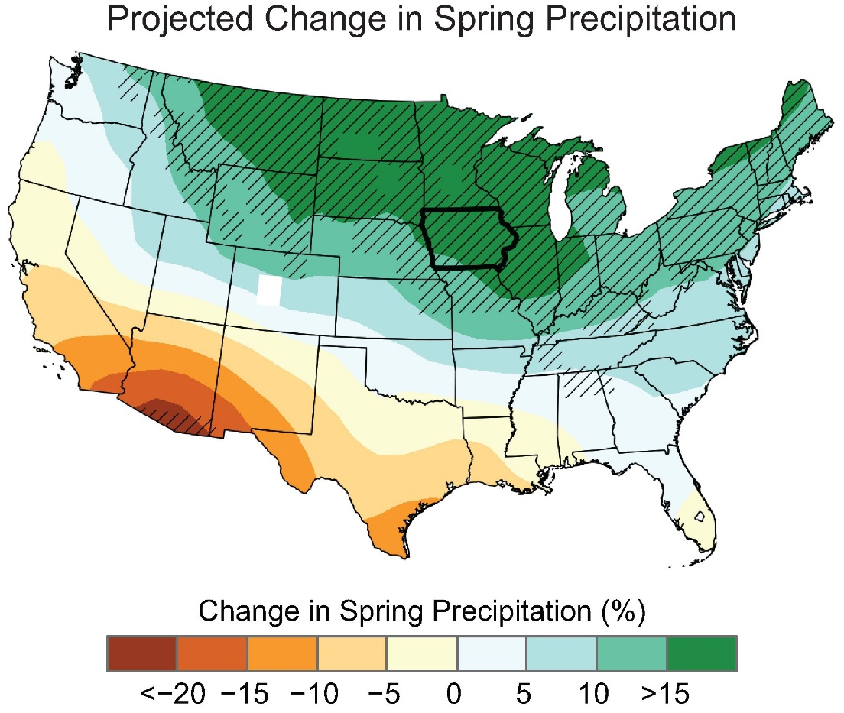
Future Trends
Middle of the 21st century vs
late 20th century

Slide 18
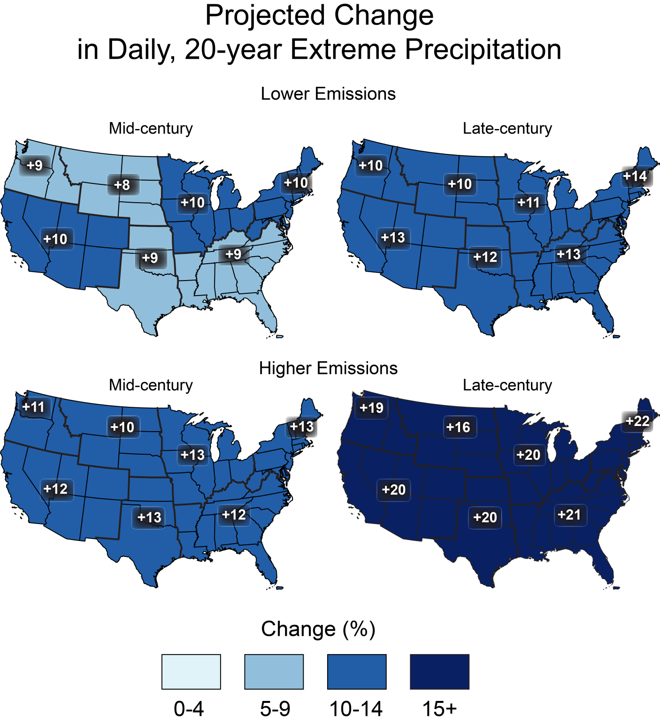
Future Trends
20-year extreme = 5% chance each year

Slide 19
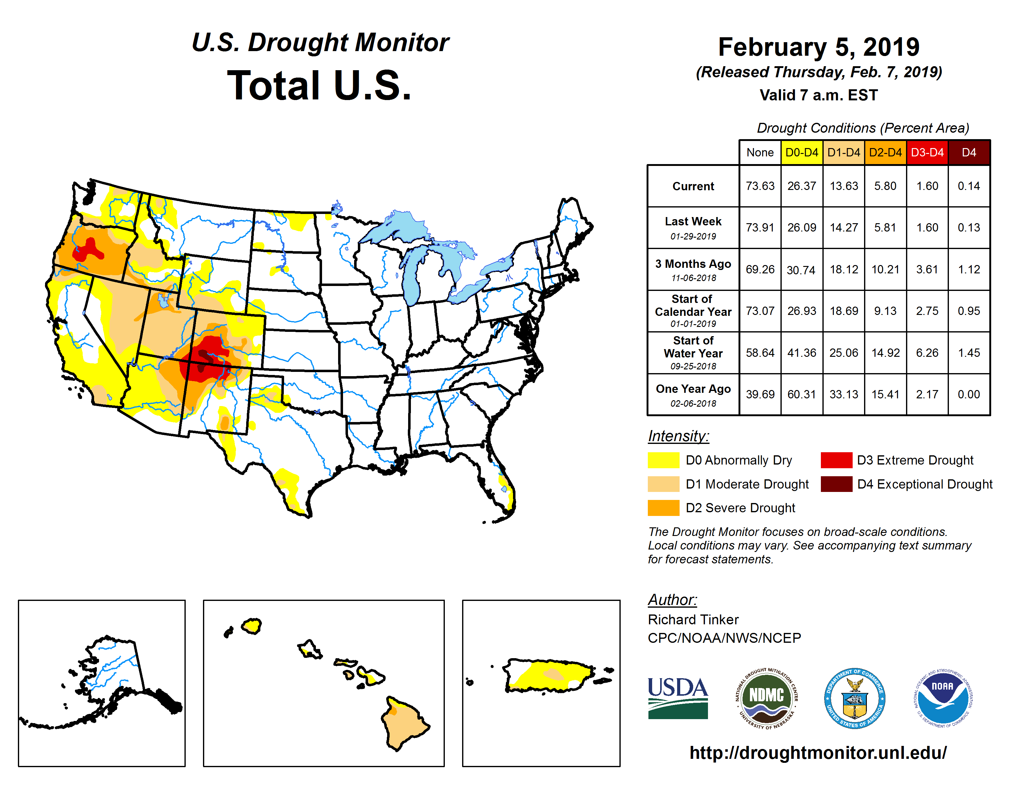
Drought?
May see an increase in drought!
Warmer temperatures = increase in
evaporation and plant transpiration (water use)
More frequent heavy rain events, but drier
periods in between, i.e., a change in
distribution

Slide 20
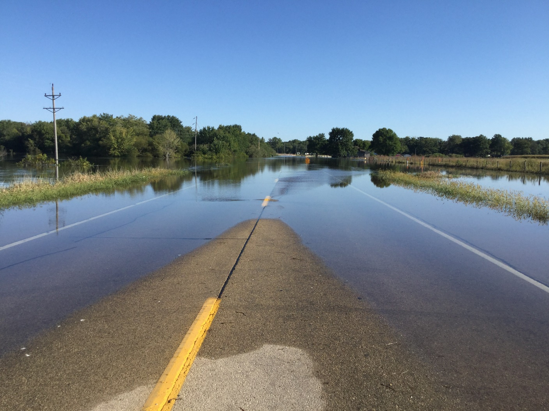
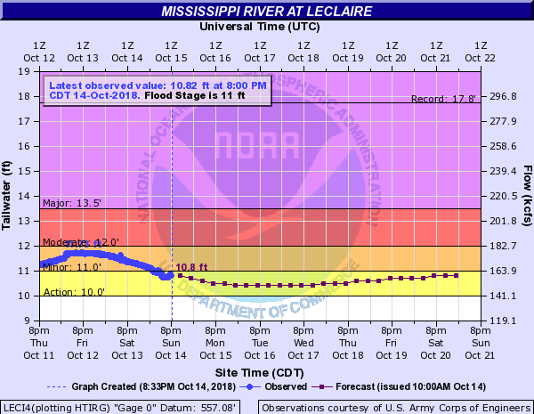
Ray Wolf – ray.wolf@noaa.gov
National Climate Assessment https://nca2018.globalchange.gov/
Wapsipinicon River September 2018
Mississippi River Flood at LeClaire October 2018

